Slide 1
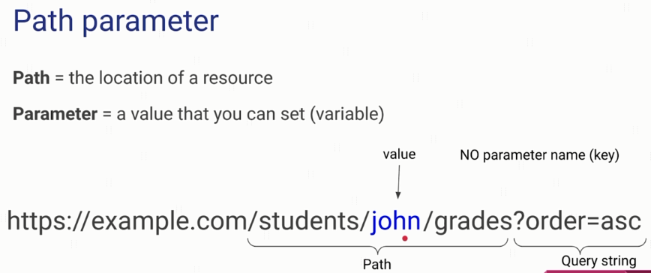
What are Path Parameters?

Slide 2
What are Query Parameters?
https://openlibrary.org

